Slide 1



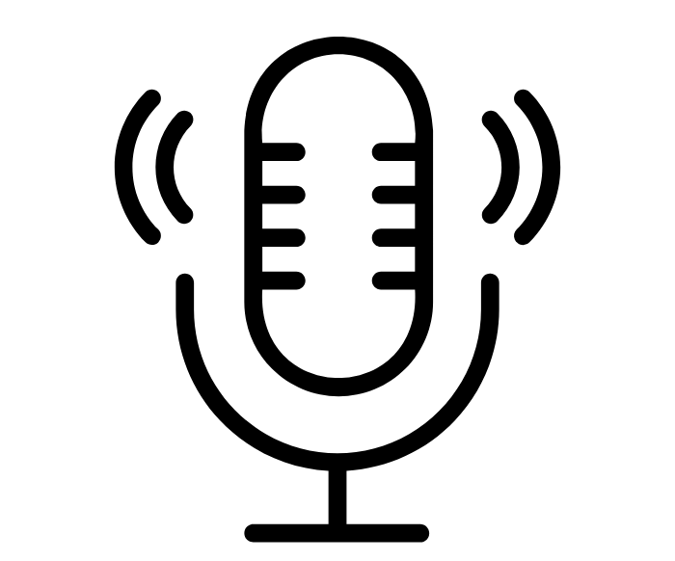


 |  | Diaries | Historical Books | Posters / Adverts | Account / Interview
N | Nature: What type of source is it? HINT: Is it a photo, cartoon, written account | Useful Gives day-to-day events. Contains the emotions or feelings of a person. Less Useful Gives only one viewpoint. This is a ‘narrow’ view. | Useful Usually well researched by someone in the historical field. Less Useful Depending on the sources used, might contain bias. | Useful Great for showing the views of people at the time. Shows how people thought. Less Useful Often contain bias rather than real facts or evidence. | Useful Good for finding out a person’s experiences who lived through events. Less Useful Interviewed people could hide certain facts or lie.
O | Origin: Who made the source? When was it made? Where was it produced? HINT: Read the caption! | Useful It written at the time, we get the person’s first-hand experience. Even if written later, a person might feel more confident revealing info. Less Useful People sometimes forget things if they write it years later. | Useful Written by someone who is an expert in the subject and who may have researched. The person isn’t influenced by events at the time. Less Useful The person doesn’t may not have first-hand experience of the events. | Useful Usually created by someone there at the time. The artist could be someone well informed, making it more accurate. Less Useful Often have the bias of the creator. Could have inaccuracies which stretch the truth. | Useful If the person was someone in a key position, the info is more official, trustworthy. Person might have been there, so true experiences. Less Useful If years later, does the person remember? Only one point-of-view.
P | Purpose: Why was the source produced? HINT: Weigh up whether the creator had a reason for making it. | Useful Diaries are normally personal, so a person has no reason to lie. Less Useful If published, a person might exaggerate facts to make themselves sound better. | Useful Usually to inform, or educate, so must be accurate and truthful. Usually neutral and factual. Less Useful Sometimes can be difficult to read if written in academic language. If ‘general’ history, then it might lack detail. | Useful Posters normally try to convince, so we see what people were being told or convinced of at the time. Less Useful Mostly used as propaganda, so may contain less facts and more exaggeration. Might be used to fit the agenda of the government in charge at the time. | Useful If informative, then the person will likely tell the truth. Less Useful If it’s for entertainment, the person might stretch the truth for comedic purposes. Interviewers might bend the question to get the truth they want.

Slide 2
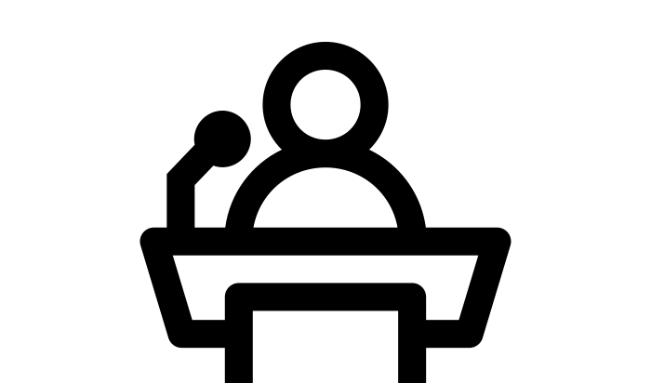



 |  | Newspapers | Speeches | Cartoons | Photographs
N | Nature: What type of source is it? HINT: Is it a photo, cartoon, written account | Useful A firsthand account of events, providing a snapshot of what was happening at the time. Less Useful A newspaper often reports quickly so sometimes contain factual errors or leave some parts out. | Useful They give a chance to hear a person or hear what they feel about a point in time. Important speeches record Less Useful Speeches might exaggerate for effect. The language will reflect the goals of the speaker. | Useful Visual representation of what people thought at the time, usually funny and based on real events. Less Useful Drawings don’t always accurately portray people, places or events. Easier to fake than a photo. | Useful Show a snapshot in a point in time. Difficult to fake. Don’t have bias, just show something as it is. Less Useful Doesn’t show the whole situation or bigger picture, might miss things out.
O | Origin: Who made the source? When was it made? Where was it produced? HINT: Read the caption! | Useful Author might have been there at time. The article might quote important people who are experts. Less Useful The article may reflect the bias of the author. Often one sided. | Useful Great to hear the opinions or experiences of the speaker. A person of authority will be in a position to know more. Less Useful Is the person an expert, or connected to key events? How long after was it made? | Useful Neutral artists may present true events or opinions. It could show accurate opinions at time. Less Useful It may be a biased viewpoint of the artist. Is artist forced? Influenced? | Useful Often comes from the time, showing a real situation happening. Less Useful Was the photographer being biased? If so, he may have taken the photo from a certain angle.
P | Purpose: Why was the source produced? HINT: Weigh up whether the creator had a reason for making it. | Useful If written to inform, it will give accurate facts available at the time. Less Useful If it is a government paper, the article may be biased in their favour. It might exaggerate to sell copies, rather than tell the whole truth. | Useful Even if it’s propaganda, it shows what people were told at the time. Also, shows what the speaker feels or thinks. Less Useful Are the audience being informed or convinced? If a propaganda speech, the opinions could be exaggerated. | Useful If used to entertain, it gives a funny impression of real views at the time Less Useful Usually used as propaganda to influence people, so it’s not always as historically accurate. | Useful If educational or private, or for official records, then it may give more trustworthy view. Less Useful If people are posing, could it be staged? Might have been taken as propaganda and have been set up.

